Slide 1
AR Mobile Application
Course: DVA232
Group: 03
Members: Max Strang, Liam Burberry Gahm, Erik Isaksson and Mika Pärssinen.

Slide 2

01
Our last goal
02
What we have done this week
CONTENTS
03
What we will do after this
04
Goals for presentation

Slide 3
Our last goal
Be able to scan QR codes
Make a design
Make Prefabs
Connect with the API

Slide 4
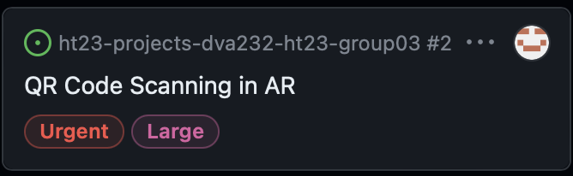
What have been done?
ZXing.Net (Zebra crossing)
CPUImage or GPUImage?

Slide 5
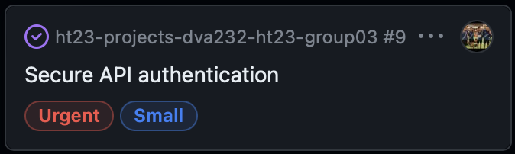
What have been done?

Slide 6
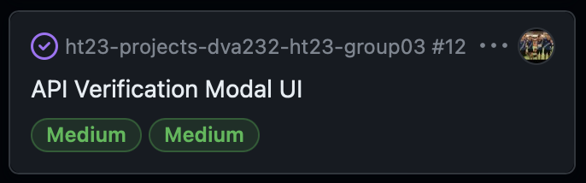
What have been done?

Slide 7
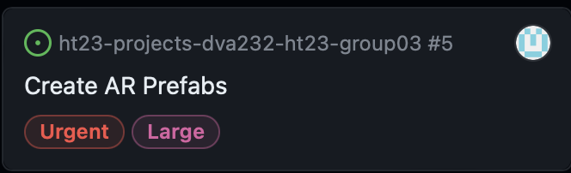
What have been done?

Slide 8
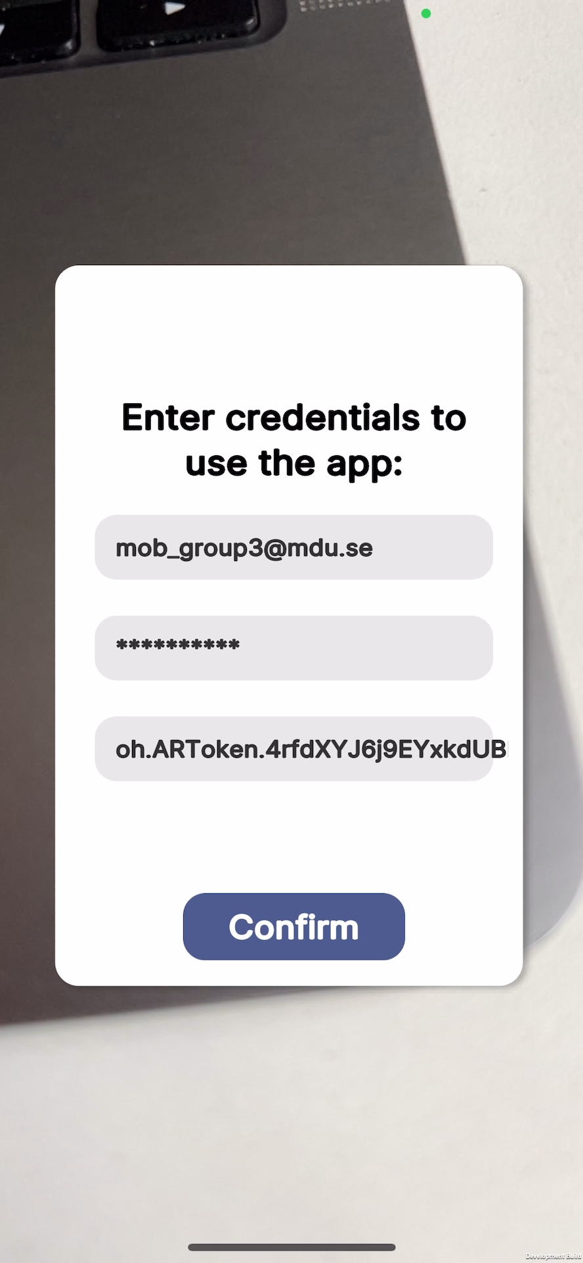
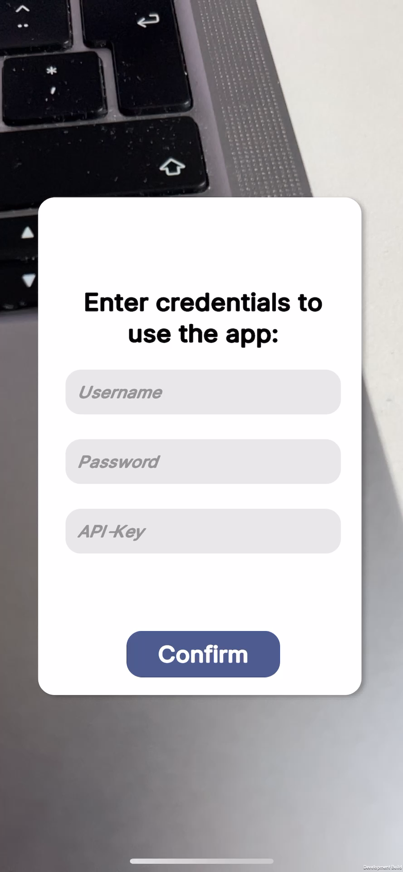

Slide 9
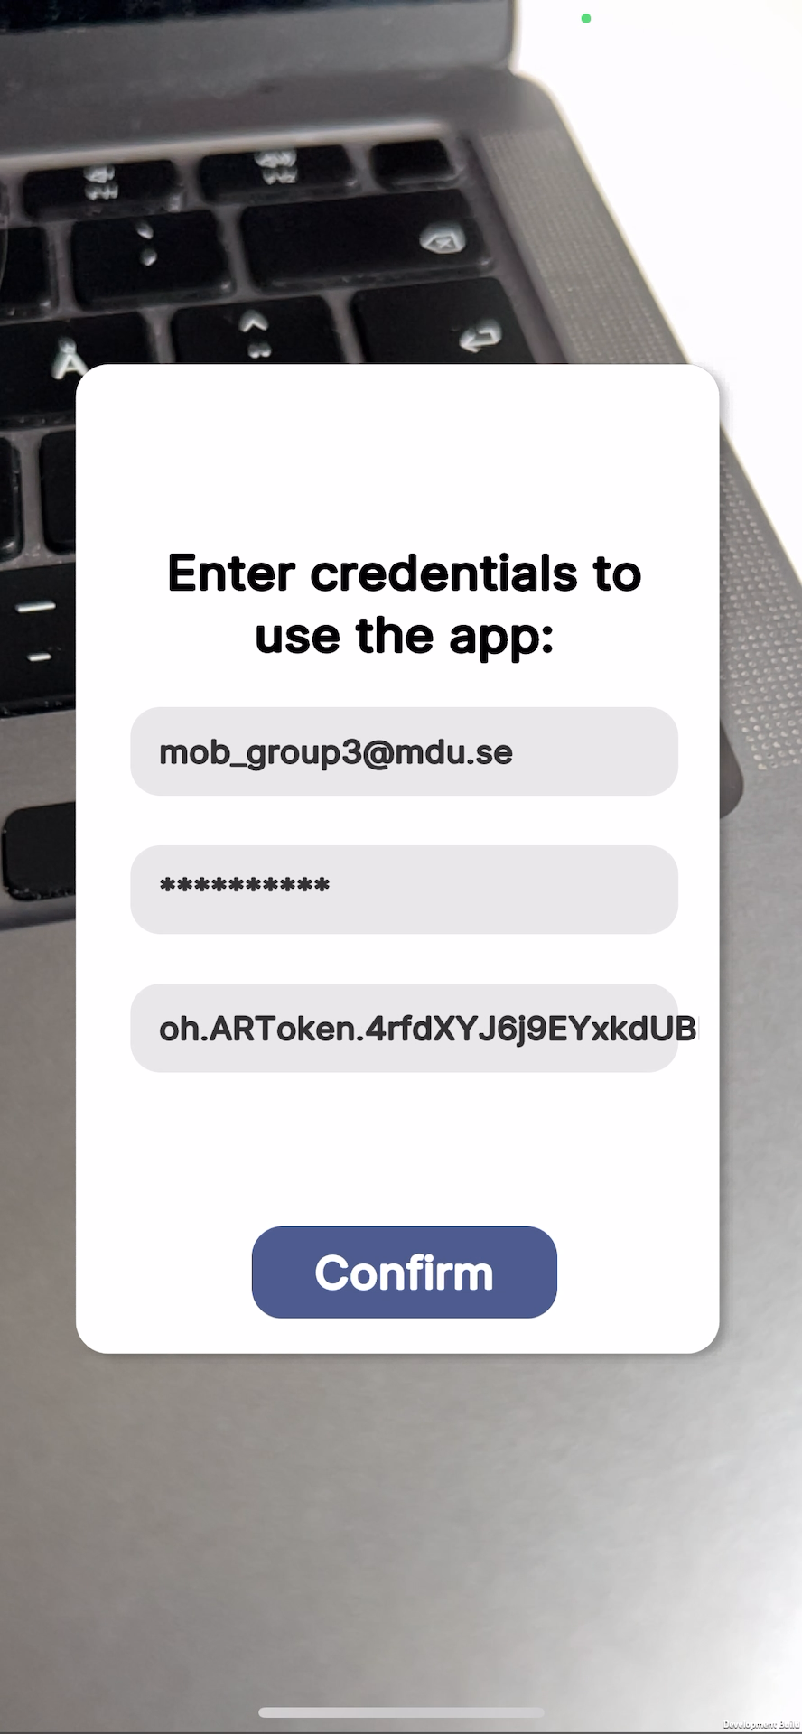
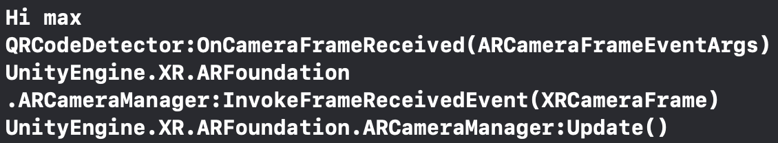
Console:

Slide 10
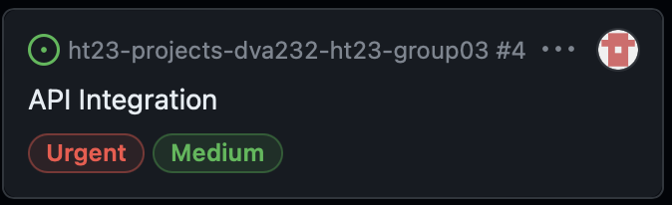
What have been done?

Slide 11
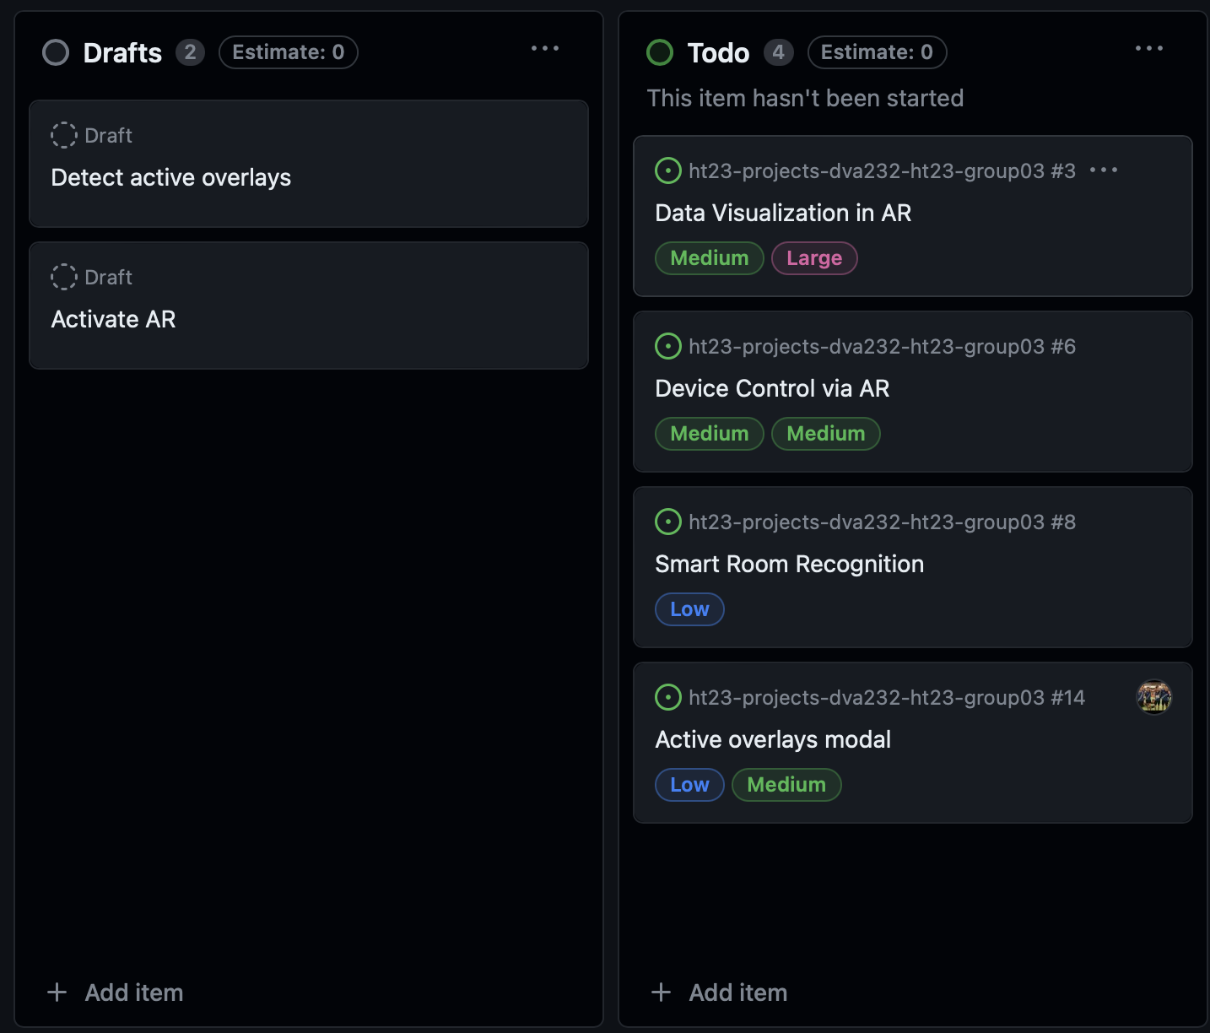
Moving forward

